Slide 1


{{image}}
PROPOSAL Vulnerability Assessment and Penetration Testing (VAPT)
Date of Submission: 2023-10-01
Version 1.0

Slide 2
TABLE OF CONTENTS
Sr. No. | Section | Mapping
1 | Company Profile | 03
2 | Project Overview | 20
3 | Introduction to VAPT | 23
4 | Delivery Methodology | 26
5 | Project Deliverables | 36
6 | Project Timeline | 38
7 | Project Management | 40
8 | Financials | 47
9 | Contact Us | 49

Slide 3


COMPANY PROFILE

Slide 4

ABOUT US
GRC360 is a vendor-neutral professional consultancy and audit firm with specialized focus on information security and data protection.
We are PCI SSC approved Qualified Security Assessor (QSA) for PCI DSS. Our consultants collectively possess more than a-century-long experience working with large enterprises and governments . We deliver coherence for your governance, risk management and compliance needs.
4

Slide 5
OUR CORE VALUES
Our Vision
Shaping the future of the information- and cyber-security ecosystem by countering challenges through innovation and experience.
Assisting enterprises around the world by delivering outstanding quality services.
Setting standards of excellence by instilling pride of ownership and commitment.
Exceeding Client’s expectations through dedicated power of talented consultants.
Our Mission
We aim to achieve the highest quality in delivering our consultancy services to strengthen our Client’s governance, risk posture and information security resilience.
5

Slide 6



GLOBAL FOOTPRINT
Bahrain
We have your back around 4 continents

Slide 7

INTERNATIONAL SERVICES
PCI DSS COMPLIANCE
PERSONAL DATA PRIVACY CONSULTANCY SERVICES
Our QSAs will ensure that your PCI compliance journey is easy and smooth.
GRC360 provides Data Privacy services according to regional regulations such as PDLP, NDMO etc.
RED TEAMING
We test your security implementations and SOC with realistic attack simulation.
SECURITY ASSESSMENTS
Our consultants conduct database, network, infrastructure, and applications assessment.
SENSITIVE DATA DISCOVERY
We are official partner of Ground Labs, purpose-designed sensitive data discovery solution for any data security initiative
IRAP ASSESSMENTS
We are certified under ACSC’s Infosec Registered Assessors Program (IRAP) for conducting security assessments and validating the effectiveness of security controls.
ISO 27001 CONSULTANCY SERVICES
We assist and expedite on the complex journey of ISO 27001 compliance.

Slide 8
INTERNATIONAL SERVICES
PENETRATION TESTING
THREAT HUNTING
We provide 24x7 VAPT Platform for continual VAPT services along with expert traditional VAPT services.
Our experts will look for adversaries present in your IT infrastructure.
DEVOPS
GRC360
Our DevOps team manages the relationship between operations and development to ensure that everything runs smoothly throughout the entire lifecycle of your application.
We provide gap assessments and compliance assistance for international standards and frameworks like SAMA CSF, NCA ECC etc.
INFRASTRUCTURE SERVICES
CYBERSECURITY TRAINING
We deliver services to implement and configure WAF, FIM, IDS, IPS, Firewalls, and DLPs in your infrastructure.
We deliver cyber security awareness and technical training for your professionals.

Slide 9
REGIONAL SERVICES (SAUDI ARABIA)
SAMA CONSULTANCY
NCA CONSULTANCY
We assist and expedite on the complex journey of SAMA compliance (MVC, CRFR, CSF).
GRC360 can provide you implementation guideline and can make you ready for ECC/CCC Assessment and Compliance.
CMA CONSULTANCY
DATA PRIVACY CONSULTANCY
GRC360 can provide you consultancy to Implement Cybersecurity Guidelines for Capital Market Institutions.
GRC360 provides Data Privacy services according to regional regulations i.e., PDPL, NDMO.
CITC (CRF) CONSULTANCY
GRC360 can provide you consultancy to Implement Cybersecurity Regulatory Framework (CRF) by CITC (Communications and Information Technology Commission).

Slide 10
REGIONAL SERVICES (QATAR)
QCB (Qatar Central Bank) CONSULTANCY
The main purpose of the QCB cyber security circular is to provide guidance to bank users, employees, contractors and other authorized users, of their obligatory requirements for protecting the technology and information assets of the bank.
GRC360 can provide you consultancy to implement cybersecurity circular by QCB (Qatar Central Bank) and can make you ready for QCB CC circular Assessment and Compliance.

Slide 11

















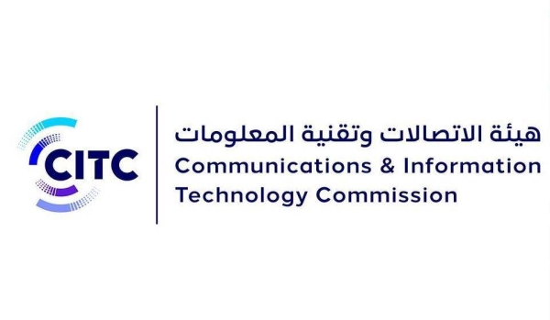
INFORMATION SECURITY RESOLUTION
COMPLIANCE
We deliver compliance services including but not limited to the mentioned standards and regulations
Enterprise Technology Governance & Risk Management Framework
Cyber Security
Framework
National Information Assurance Standard (NIAS)
Abu Dhabi Healthcare Information and Cyber Security
11

Slide 12

OUR CLIENTS

Slide 13


OUR CLIENT INDUSTRIES
TELECOM
FINANCIAL SECTOR
OIL & GAS
We have delivered exceptional services to multiple telecom operators in Middle East and Pakistan
Bank and insurance companies have benefitted from our compliance and security services
We have successfully met the growing demand of cyber security in energy sector
INFORMATION TECHNOLOGY
GOVERNMENT
FMCG
Companies like application developers, service providers also need our expertise and experience
We served the unique cyber security needs of government sector in multiple countries
GRC delivered security services to protect supply chain and ensure resilient IT infrastructures.
13

Slide 14
















Banking Sector
Our selected esteemed partners(Around the globe)
14

Slide 15








TELECOMMUNICATION SECTOR
Our selected esteemed partners (Around the globe)
15

Slide 16






























Fintech
Our selected esteemed partners(Around the globe)
16

Slide 17













Service Providers
Our selected esteemed partners(Around the globe)
17

Slide 18

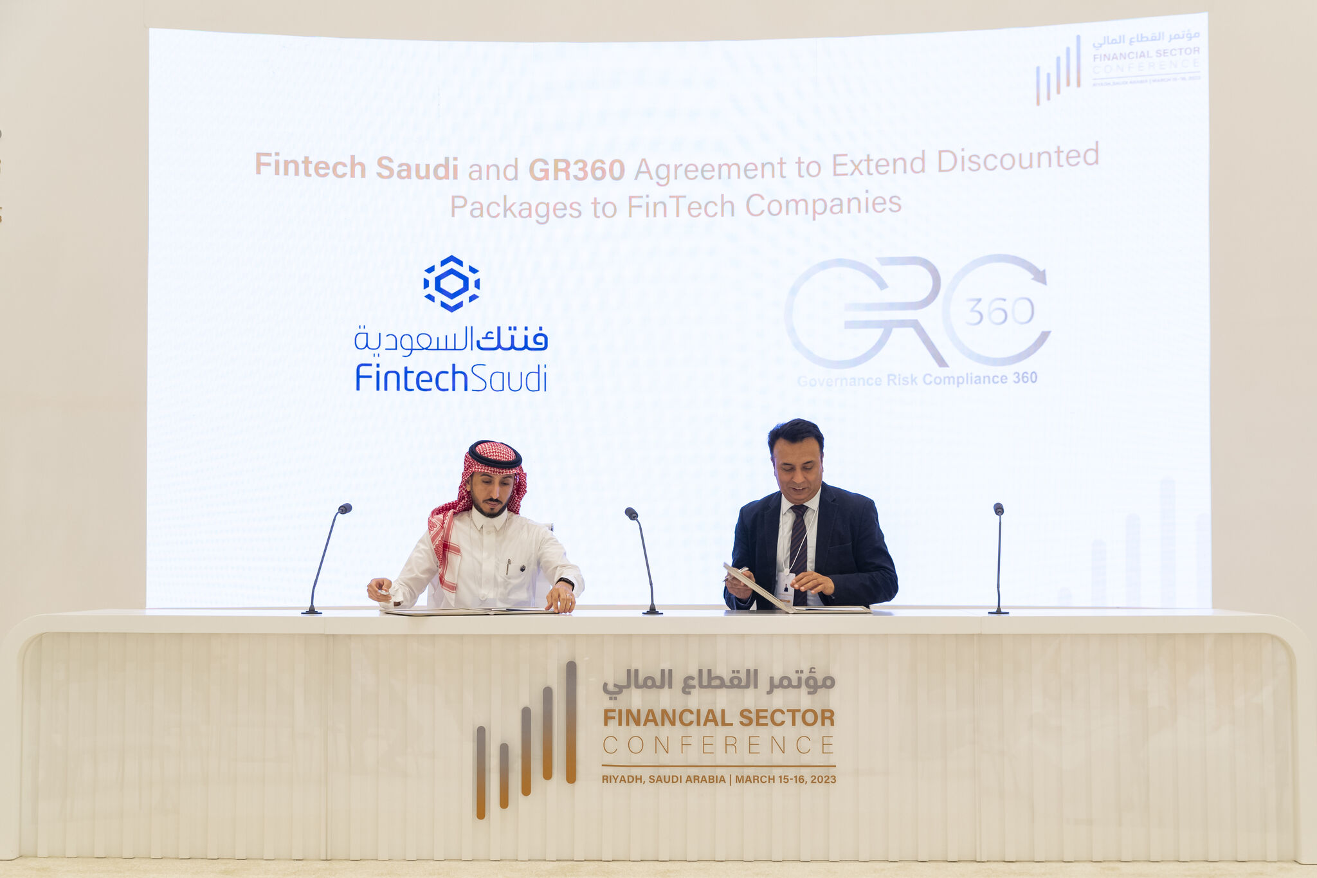
MOU SIGNING WITH FINTECH SAUDI
During the Financial sector conference, held on 15th March 2023 in Riyadh Saudi Arabia, Fintech Saudi | فنتك السعودية and GRC 360 signed a memorandum of understanding to extend discounted packages to fintech companies in KSA.

Slide 19




OUR COMPETITIVE ADVANTAGE
GRC360 is pleased to submit this proposal to enable Dummy Company to achieve its objectives. Following are some of our salient features / unique value proposition:
Credentials
Independence
Experienced Resources
0
Our Commitment
Cost Effectiveness
GRC360 will be mobilizing exceptionally talented Cyber Security professionals, leveraging industry knowledge and international best practices.
GRC360 is providing top notch Cyber Security services. We have worked on similar assignments at various organizations in the kingdom. Therefore, we are confident to add-value to Dummy Company .
GRC360 views Dummy Company as its one of its strategic and prestigious Client in the region. Considering this strategic importance, Senior Management of GRC360 is committed to provide its best resources and attention to ensure successful completion of the engagement.
We maintain complete independence in our engagements.
Outstanding services at a cost-effective fee. We optimize our fee by assigning experts and actively involving your team to synergize, avoid duplication. Also, we have heavily discounted our fee to start and cherish our relationship with Dummy Company .

Slide 20


PROJECT OVERVIEW

Slide 21

EXECUTIVE SUMMARY
GRC360 renders services related to cyber security for assessing, analyzing and improving information security of our valuable clients. We help in providing solutions that could lead to the development of sustainable, efficient and resilient system.
This presentation provides the holistic approach of methodology to conduct Dummy Service for Dummy Company. Our extensive experience ensures our Clients are better able to withstand the impacts of evolving cyber threats and comply with related standards and regulations.
21

Slide 22


PROJECT SCOPE
The project aims to provide the following services to
Dummy Company:
Dummy Bullet Point 1
Dummy Bullet Point 2
Dummy Bullet Point 3

Slide 23

Introduction to Vapt

Slide 24

OUR VAPT SERVICES
GRC360 has delivered multiple Vulnerability Assessment and Penetration Testing services to Clients in UAE, Saudi Arabia, Australia and Pakistan. Our team comprises of certified hackers and vulnerability researchers with years of experience as bug bounty hunters and holding CEH, OSCP certifications. We also deliver red teaming and blue teaming services to ensure comprehensive cyber security protection.
We are delivering vulnerability assessment and penetration testing services in following domains:
Web/ Mobile Applications
Networks
Servers & Endpoints
Databases
Cloud
IoT devices

Slide 25
OUR PT SERVICES
A Penetration Test is an attempt to find the security weaknesses of a system and intentionally attack the system with legal approval, in order to identify loopholes that an attacker could exploit to compromise organizational assets.
Grey Box Testing: Grey box testing is when the tester has a partial understanding of the internal structure in the system. Grey Box testers have access to the detailed design documents along with information about requirements.
White Box Testing: It is the testing strategy where the tester deeply understands the inner workings of the system or system component being tested.
Black Box Testing: Black-box testing ignores the internal mechanism of a system or component and focuses solely on outputs generated in response to selected inputs and execution conditions.

Slide 26

DELIVERY METHODOLOGY

Slide 27
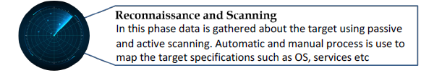
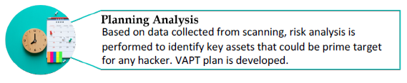
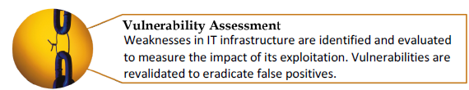
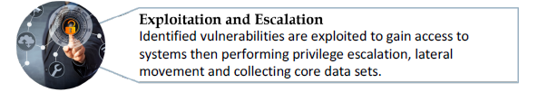

VAPT -DELIVERY METHODOLOGY
GRC360’s methodology is intended to serve as high level directional guide for the development of secure and effective penetration testing. The five-phased methodology is based upon ISSAF, PTES, OWASP & PCI DSS standards.
Our methodology offers best practices on conducting penetration testing aligned with the AlSagr’s needs & expectations. Each phase reflects a portion of the mentioned standards. GRC360’s main objective is to revolve the methodology around the industry best practices, and to update and roll down as per the AlSagr’s requirements.

Slide 28
VAPT - DELIVERY METHODOLOGY
Information Systems Security Assessment Framework (ISSAF)
The Information Systems Security Assessment Framework (ISSAF) is an open source, peer-reviewed penetration testing framework created by OSISSG. The framework encapsulates various methodologies & covers all possible domains of penetration testing. It links each pen-test steps with pen-testing tools.
Information gathering
Network mapping
Penetration
Gaining access and privilege escalation
Enumerating further
Maintaining access
Compromising remote users/sites
Vulnerability Identification
Covering the track

Slide 29
VAPT - DELIVERY METHODOLOGY
Pre-engagement Interactions
Intelligence Gathering
Threat Modeling
Vulnerability Analysis
Exploitation
Post-Exploitation
Reporting
Penetration Testing Execution Standard (PTES)
The Penetration Testing Execution Standard (PTES) aims to address the need for a complete and up to date standard in penetration testing. It incorporates OWASP Top Ten Framework.
Further, it provides guidance to security professionals & serves as a source of reference for businesses with respect to penetration testing requirements.

Slide 30

VAPT - DELIVERY METHODOLOGY
OWASP
OWASP provides numerous tools, guidelines and testing methodologies for cyber security under opensource license. The framework is further categorized into web applications development, web application testing methodology and reporting. The main focus is upon web application security through out the entire software development life cycle.

Slide 31
VAPT - DELIVERY METHODOLOGY
1. Injection
Injection flaws, such as SQL, NoSQL, OS, and LDAP injection, occur when untrusted data is sent to an interpreter as part of a command or query. The attacker’s hostile data can trick the interpreter into executing unintended commands or accessing data without proper authorization.
2. Broken Authentication & Session Management
Application functions related to authentication and session management are often implemented incorrectly, allowing attackers to compromise passwords, keys, or session tokens, or to exploit other implementation flaws to assume other users’ identities temporarily or permanently.
3. Sensitive Data Exposure
Many web applications and APIs do not properly protect sensitive data, such as financial, healthcare, and PII. Attackers may steal or modify such weakly protected data to conduct credit card fraud, identity theft, and other crimes. Sensitive data may be compromised without extra protection, such as encryption at rest or in transit, and requires special precautions when exchanged with the browser.
4. XML External Entities (XXE)
5. Broken Access Control
Many older or poorly configured XML processors evaluate external entity references within XML documents. External entities can be used to disclose internal files using the file URI handler, internal file shares, internal port scanning, remote code execution, and denial of service attacks.
Restrictions on what authenticated users are allowed to do are often not properly enforced. Attackers can exploit these flaws to access unauthorized functionality and/or data, such as access other users' accounts, view sensitive files, modify other users’ data, change access rights, etc.
OWASP Top
Web Application
Vulnerabilities

Slide 32
VAPT - DELIVERY METHODOLOGY
PCI DSS Penetration Testing
PCI DSS Pen-Testing is designed to include the assessment of network infrastructure and applications from both outside and inside CIRCLYS's network environment.
PT exercise shall be performed on CIRCLYS’s complete Cardholder Data Environment (CDE) and includes any systems which may impact the security of the CDE.
1. Pre-Engagement
Scope of penetration testing is finalized and documented. Rules of engagement and success criteria is determined to ensure pen tester have clear set of expectations.
2. Engagement
Actual penetration testing activity is performed using appropriate approach, tools, or techniques according to organizational needs. Applications, networks and segmentation is tested for loopholes.
3. Post-Engagement
Once penetration testing is concluded, it is reported along with remediation best practices. The organization retests the identified vulnerabilities to validate findings. Testers then clean the environment by removing the added accounts and tools.
4. Reporting & Documentation
This phase includes reporting vulnerability based on industry best scoring systems like CVSS,NVD,VCE, CWE, BID,OSVDB etc.

Slide 33



VAPT - DELIVERY METHODOLOGY
Mobile Penetration Test
Improper Platform Usage
Insecure Data Storage
Insecure Communication
Insecure Authentication
Insufficient Cryptography
Insecure Authorization
Poor Code Quality
Code Tampering
Reverse Engineering
Extraneous Functionality
OWASP Top 10 Mobile Vulnerabilities
Our penetration testing experts conduct vulnerability assessment and penetration testing of mobile applications keeping in view the OWASP top 10 mobile vulnerabilities. This ensures that our PT exercise delivers the maximum value to our Clients.

Slide 34
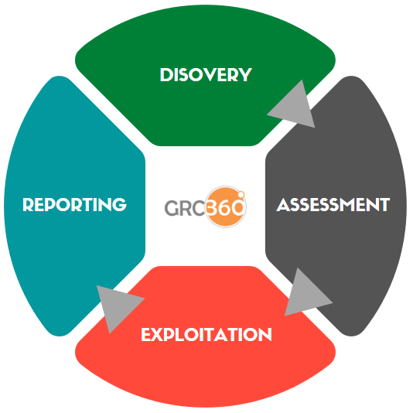
VAPT - DELIVERY METHODOLOGY
OWASP (Web Application Penetration Testing)
In the initial stage, an understanding of the architecture & underlying framework along with technologies used by web application will be developed. It includes web servers, databases, web application firewalls, load balancers and so on.
The Second stage will be the assessment of critical functions which includes working of application, supporting business functions and implementation of authentication, authorization and access control mechanisms.
After the assessment, the web application and its supporting infrastructure will be tested against publicly available exploits. Intrusive and non-intrusive exploits will be used to simulate an actual hacker attack on the particular web application and its infrastructure.
In the last stage, all the information & evidences gathered during the exercise will be analysed. A report will be formulated during this phase which shall include risk rating, tools used, detailed information regarding the weakness and the recommendations to mitigate the identified risks associated with the weaknesses.

Slide 35
VAPT - DELIVERY METHODOLOGY
OWASP Assessment Phase
Some of the tests that our consultants conduct to assess the security controls of your web applications:
Business Logic Testing
Session Management Testing
Configuration Management Testing
Authorization Testing
DDoS
(If Approved)
Authentication Testing
Data Validation Testing
Ajax Testing
Web Services Testing

Slide 36


PROJECT DELIVERABLES

Slide 37

PROJECT DELIVERABLES
Project | Activity | Deliverable(s)
PT Testing | 1. Dummy Activity 1 2. Dummy Activity 2 3. Dummy Activity 3 | 1. Dummy Deliverable 1 2. Dummy Deliverable 2 3. Dummy Deliverable 3

Slide 38


PROJECT TIMELINE

Slide 39

PROJECT TIMELINE
Estimated duration: 3 Calendar Weeks (May vary depending upon the Client’s response)
Weekly Breakdown of High-Level Project Phases
W1 |  |  |  |  | W2 |  |  |  |  | W3
Dummy Timeline 1
Dummy Timeline 2
PT Reporting
PT
Reporting
PT Team

Slide 40

PROJECT MANAGEMENT

Slide 41

PROJECT MANAGEMENT METHODOLOGY
GRC360’s methodology is based on wide professional experience and in-depth knowledge of project management. Best practices are embedded across the project management activities from initiation to closing.
INITIATION
EXECUTION
CLOSING
PLANNING
MONITORING & CONTROL

Slide 42





OUR PROJECT MANAGEMENT MODEL
GRC360’s project management approach is based upon four-step model PDCA (Plan, Do, Check, Act), which is a powerful method for implementing continual development and issue solving:
Planning involves identification of problem, and establishment of goals and target results.
Doing involves plan execution, and development and implementation of potential solution(s).
Checking measures of the effectiveness of a solution by studying the results.
Acting involves adjustment to achieve the intended results.
PLAN
DO
ACT
CHECK

Slide 43


PROJECT TRACKING AND MONITORING
GRC360 ensures that the Clients’ corporate goals and business benefits are realized through a controlled, well-managed, visible set of activities to achieve the desired results.
GRC360 has an experience of delivering full spectrum of services at every phase of project life cycle.
The Project Manager will track, review, and regulate the progress and performance of the project; identify any areas in which changes to the plan are required, initiate the corresponding changes and publish, maintain and communicate the risks to Client’s management.

Slide 44





PROJECT DOCUMENTATION
Project Plan
An elaborate project plan comprising of Gantt chart and project dashboard will be developed and updated by GRC360.
Work Breakdown Structure
WBS of project tasks will be developed that will cover task dependencies, responsibilities and duration.
Communication Plan
A communication plan to ensure timely project related information disseminate to relevant stakeholders.
RACI Matrix
Clearly defined roles and responsibilities will be developed.

Slide 45

OUR TEAM
Experienced Certified Professionals
Our team members are seasoned consultants having extensive and proven experience of providing premium consulting services to Clients ranging from Financial to governments and spanning from Asia, Middle East to Europe.

Slide 46


























QUALIFICATIONS & CERTIFICATIONS
Our Consultants have the following active certifications:

Slide 47


FINANCIALS

Slide 48


FINANCIALS
Sr. No. | Deliverables | Amount SAR
1 | Dummy Deliverable 1 | $100
2 | Dummy Deliverable 2 | $200
3 | Dummy Deliverable 3 | $300
Total |  | $1150.00
Total without VAT |  | $1000.00
Payment Terms:
Price above does not include KSA VAT,
40% on signing on and Awarding
30% after 1 month of PO
30% with project sign off

Slide 49

DUBAI, UAE
RIYADH, KSA
DOHA, QATAR
MANAMA, BAHRAIN
MELBOURNE, AUSTRALIA
ISLAMABAD, PAKISTAN
CONTACT US
WEBSITE
www.grc360.net
PHONE NUMBER
+966 503110519 (KSA)
+61 412738906 (Australia)
EMAIL ADDRESS
info@grc360.net

